Slide 1

Grammar & Basics
Prepositions & Conditionals

Slide 2
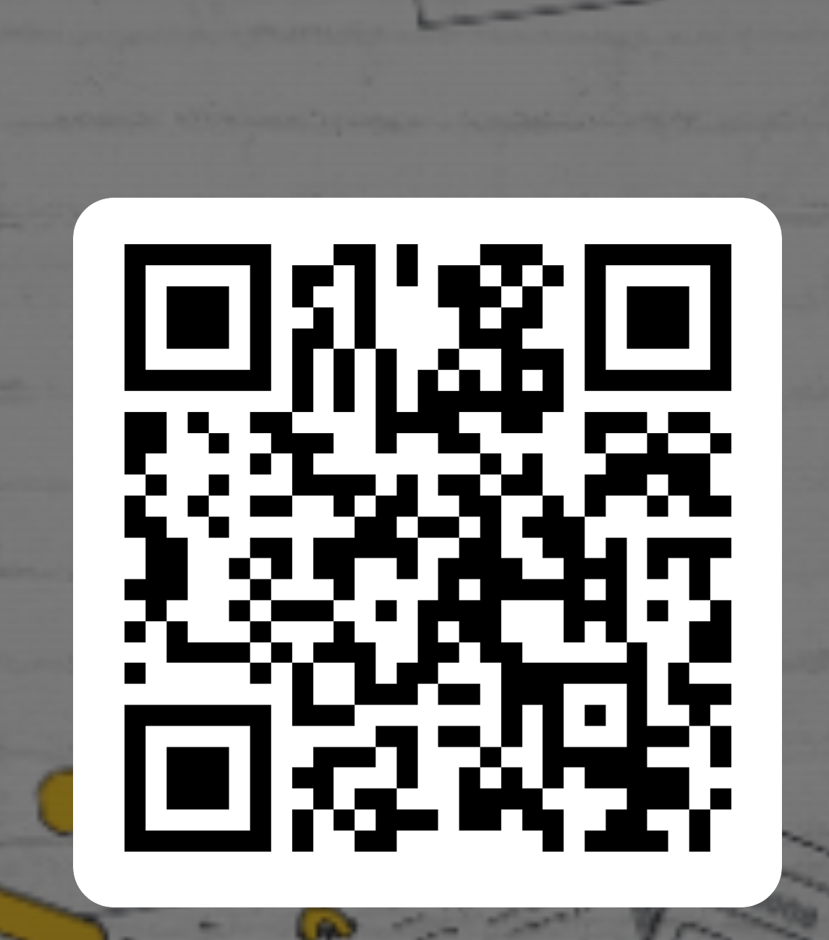
Getting started: what do you already know? Using the right preposition
Fill in Attendance: https://forms.office.com/e/9xF4TLDXZZ
Each sentence contains an error with the underlined preposition. In each case, Try your best to correct it to the right preposition.
She is engaged with David
She entered into the room.
He is intelligent, but he lacks of experience.
Except coats or sweaters, you are not allowed to wear outer clothing.
On October, we went for a skiing vacation in Switzerland
Every summer I fly to Brazil and sit in the beach.
He decided to protest over the depiction of violence towards animals.
He told to me that he liked it.

Slide 3
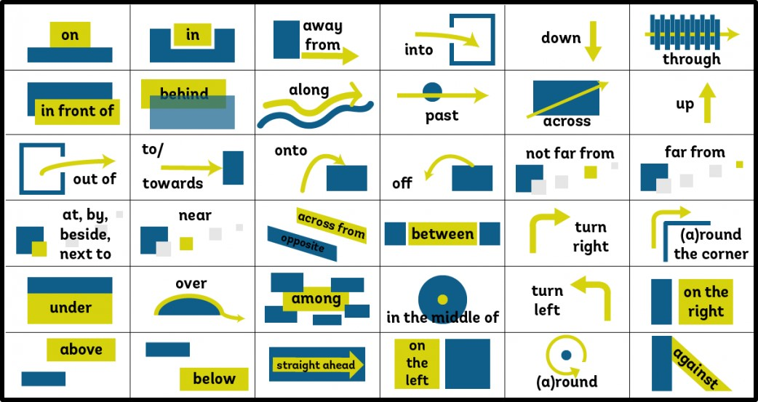

Slide 4
Prepositions
Are used to express:
Time: in, on, at, after, before etc.
Position: in, on, at, behind, in front of etc.
Movement: into, out of, off, across, from etc.
Other relations: by, about etc.

Slide 5
KEY Using the right preposition
She is engaged to David
She entered the room. [no preposition!]
He is intelligent, but he lacks experience. [no preposition!]
Except for coats or sweaters, you are not allowed to wear outer clothing. [preposition is needed!]
In October, we went for a skiing vacation in Switzerland
Every summer I fly to Brazil and sit on/at the beach. [meanings differ slightly, though both are correct]
He decided to protest against the depiction of violence towards animals. [also correct: no preposition]
He told me that he liked it. [no preposition!]

Slide 6
Prepositions
Can be confusing for Dutch native speakers as they are not always the same in translation
He is in the garden → hij is in de tuin
He will be there in 5 minutes → hij is er over 5 minuten
Find logical patterns
If you already know it’s “in September”, it must also be “in October”, etc.
If you know it’s “at lunch”, then it must also be “at dinner”
Other ways to learn them
Dictionary
Read a lot
Learn often used phrases off by heart

Slide 7

Confusing cases – I
Some prepositions that look alike or translate to the same Dutch word are discussed on the following slides
After that some common mistakes based on ‘false friends’
(= words that look alike in two different languages but don’t mean the same) are discussed

Slide 8
Confusing cases - II
Write a sentence (in pairs or threes) with both and explain the difference between them.
During or for?
For = how long
He worked here for 2 months.
During = when
We met some nice people during our holiday.
Compare:
I fell asleep during the movie. I slept for half an hour.
Note: while is not a preposition, but a linking word, so it’s followed by a clause/sentence (with subject and verb)
We met some nice people while we were on holiday.

Slide 9

Confusing cases - III
Write a sentence (in pairs or threes) with both and explain the difference between them.
In or into?
In = position
I’m in the bathroom.
Into = movement
He walked into the bathroom.
The opposite of into is out of
I told him to get out of the bathroom.

Slide 10

Confusing cases - IV
Write a sentence (in pairs or threes) with both and explain the difference between them.
To or till?
To = movement
We drove to Paris, but then we had to take a rest.
Till = time
My wife drove till 7.00, and then I took over.
Note: ‘too’ with two o’s is not a prepostion, and can mean:
‘also’: I saw him too.
Dutch ‘te’: He drank too much.

Slide 11
Confusing cases - V
Off or of?
Off is the opposite of on
He switched the computer off and on again.
The book was on the table, but then it fell off.
Of is used in all other cases (usually translates to Dutch ‘van’)
He is the head of our department
She cried tears of happiness.

Slide 12
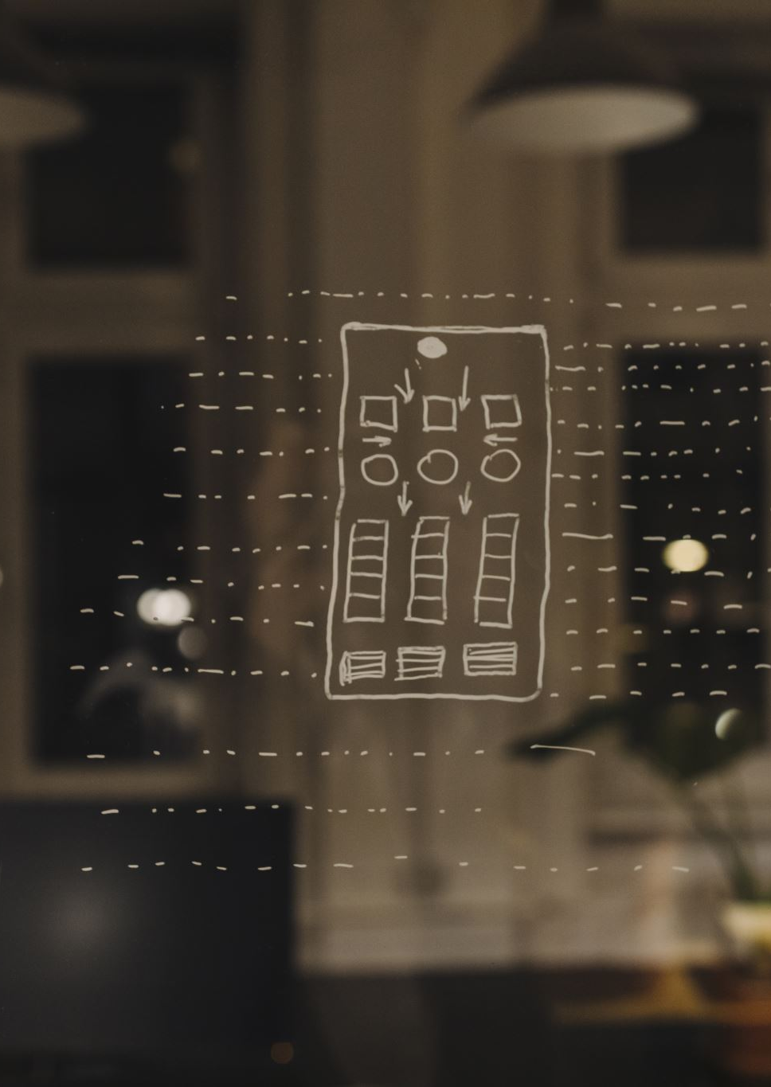
Confusing cases - VI
Before, in front of or for?
Before = time
Shall we meet before 7:00?
In front of = position
Ok, I’ll be waiting in front of the restaurant.
For = other
I will bring something special for you.

Slide 13



Confusing cases - VII
As or like?
As refers to a job or function
He works as a clown at children’s parties.
Like is used to talk about things being similar
He acted like a clown in class today.

Slide 14
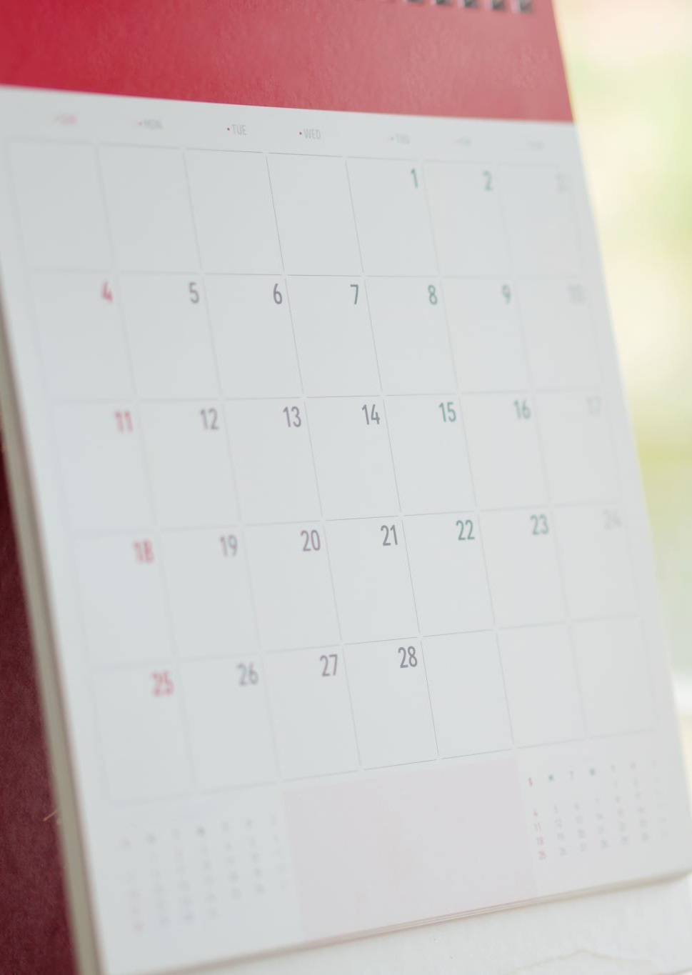
Confusing cases - VIII
In time or on time?
In time means ‘early enough’
I was in time for the announcement of the winner.
On time means ‘at the right time’ or ‘on schedule’
The show started right on time.

Slide 15
Common mistakes by Dutch native speakers - I
Which is correct? Explain the difference to highlight the error
I’m not good in English
I’m not good at English
I’m still at school
I’m still in school
I’m still on school
I was sitting at the computer
I was sitting behind the computer.

Slide 16
Common mistakes by Dutch native speakers - I
Which is correct? Explain the difference to highlight the error
I’m not good in English
I’m not good at English
I’m still at school
I’m still in school
I’m still on school
I was sitting at the computer
I was sitting behind the computer.

Slide 17
Common mistakes by Dutch native speakers - II
Which is correct? Explain the difference to highlight the error
I go to school with the train.
I go to school by train.
He has worked here since two months
He has worked here for two months
I am at the baker’s.
I am by the baker’s.

Slide 18
Common mistakes by Dutch native speakers - II
Which is correct? Explain the difference to highlight the error
I go to school with the train.
I go to school by train.
He has worked here since two months
He has worked here for two months
I am at the baker’s.
I am by the baker’s.

Slide 19
Exercise
1. _________________ 10 o’clock PM, _________________ the latest, I will have handed in my essay.
2. _________________ one year’s time, I will be receiving my diploma!
3. I arrived so early that the main doors weren’t even open yet. So I just stood there _________________ the building until I was allowed in. _________________ a moment I considered walking _________________ the building to the back door. But _________________ course, I knew it would be locked as well.
4. I’m so bad _________________ organizing my day. I hardly even wake up _________________ time to eat a proper breakfast.
But then again, I have noticed that my 9:00 lecture never seems to start _________________ time.
My professor is usually five minutes late. I hear she’s been doing this _________________ many years, but she just gets away with it.
I probably arrive _________________ school even before she does!
Well maybe not, but I’m certainly _________________ the classroom, _________________ my desk, first. _________________ least, most _________________ the time.

Slide 20
1. By 10 o’clock PM, at the latest, I will have handed in my essay.
2. In one year’s time, I will be receiving my diploma!
3. I arrived so early that the main doors weren’t even open yet. So I just stood there in front of the building until I was allowed in. For a moment I considered walking around the building to the back door. But of course, I knew it would be locked as well.
4. I’m so bad at organizing my day. I hardly even wake up in time to eat a proper breakfast.
But then again, I have noticed that my 9:00 lecture never seems to start on time.
My professor is usually five minutes late. I hear she’s been doing this for many years, but she just gets away with it.
I probably arrive at school even before she does!
Well maybe not, but I’m certainly in the classroom, at my desk, first. At least, most of the time.

Slide 21
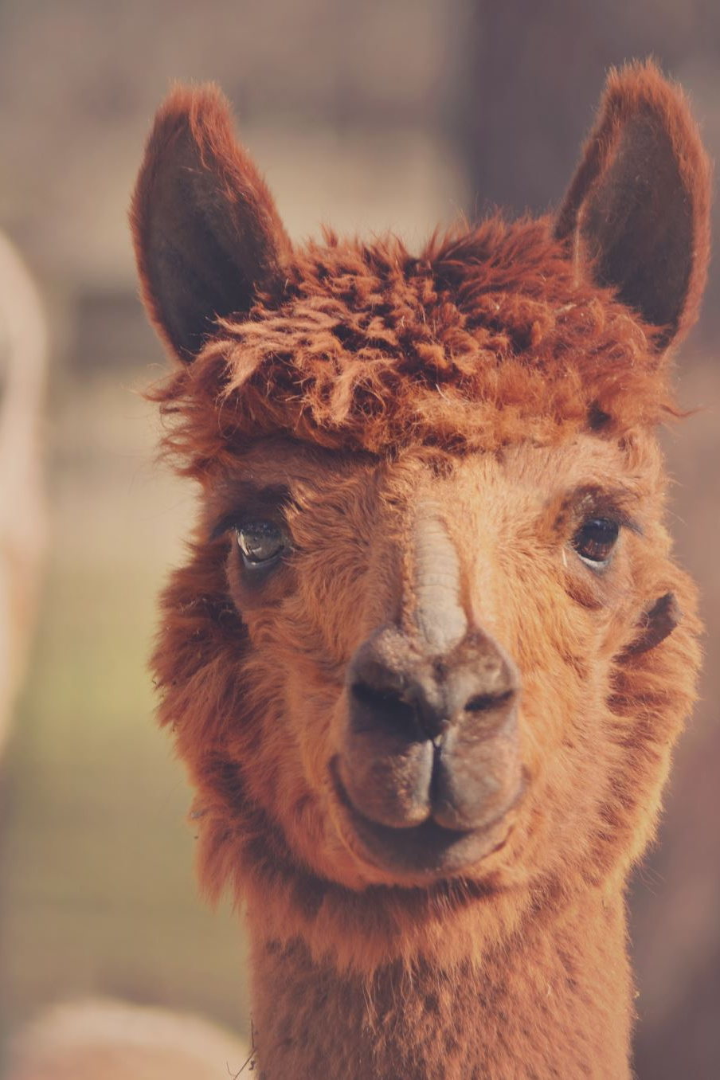
Grammar & Basics
If-Conditionals

Slide 22
Grammar – conditionals
Week 5

Slide 23
Conditional sentences
What are they?
“if”-sentences
3 different types
What do conditional sentences contain? Two clauses:
a conditional clause: begins with the word“if” (or “when”/ “whenever”/ “anytime”) + VERB
a main clause: which also has a VERB
Example: “If I lived another 100 years, I still would not be able to figure this out.”
*The “if” clause often comes first, but it doesn’t need to.
Trickiest part about conditionals: getting the verb tenses right.
So here’s a run-down of the 3 different combinations of verb tenses you will need to know…
→

Slide 24
All 3 possibilities of verb tenses found in conditional sentences
If you ask me for help, I will give it to you.
If you asked me for help, I would give it to you.
If you had asked me for help, I would have given it to you.
There are specific reasons for using each type, which appear later in the PPT.
For now, let’s use the above information to try to do some practice sentences.

Slide 25
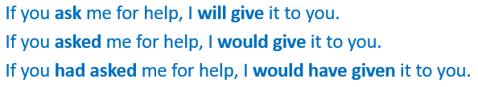
Exercise
The “if” side has already been filled in for you. Based on that verb tense, complete the sentence with a verb of your choice, making sure it’s in the proper tense. If in doubt, use the model sentences in blue to determine what the correct verb tenses should be in each case. (Note: The first blue sentence does not necessarily correspond with the first practice sentence, and so on.)
1. If I won the lottery, __________________________________________________________.
2. If she had studied harder, _____________________________________________________.
3. If it is sunny tomorrow, _______________________________________________________.
Notes:
Padlet could be used to good effect here.

Slide 26
Exercise
This time the main clause has been filled in for you instead. Based on that verb tense, complete the “if” part of the sentence with a verb of your choice, making sure it’s in the proper tense. The model sentences in blue can help.
4. I would have gotten here earlier, if only __________________________________________________________.
5. If__________________________________________________________________________, I will let you know.
6. We would be so much happier in the world if _____________________________________________________.

Slide 27
Conditionals: Fill in the missing verb
Fill in the missing verb in the correct tense. Use the blue model sentences to help you determine what that verb form should be.
If I __________________ (KNOW) she was ill, I would have sent her some flowers.
If my flat __________________ (HAVE) a balcony, I would grow plants.
Where __________________ (you/LIVE) if you could choose?
I can’t see Mary. If she __________________(BE) taller, I could see her.
If I __________________(PLAY) better, the team would have won the match.
If I catch the train at one, I __________________ (ARRIVE) in time
I would buy organic food if it __________________(BE) cheaper. At the moment it is too expensive.
She __________________ (not/GO) to University if she hadn’t worked so hard in school.

Slide 28
Conditionals: Fill in the missing verb KEY
Fill in the missing verb in the correct tense. Use the blue model sentences to help you determine what that verb form should be.
If I had known she was ill, I would have sent her some flowers.
If my flat had a balcony, I would grow plants.
Where would you live if you could choose?
I can’t see Mary. If she was/were taller, I could see her.
If I had played better, the team would have won the match.
If I catch the train at one, I will arrive in time
I would buy organic food if it was/were cheaper. At the moment it is too expensive.
She would not have gone to University if she hadn’t worked so hard in school.

Slide 29

Join the Wooclap

Slide 30
When do we use each conditional?
Explanations & added exercises

Slide 31
Type-1
Type-0. A situation that tends to be true in general.
Type-1. A specific future situation that is very likely to be true.
→ Sam, if you jump into that pool right now, you will get wet.
(This cannot be Type-0. You can’t substitute “anytime” in place of “if”, because it’s about a specific time.)
Verb tenses: if-clause - present simple | main clause - “will”+verb
*Don’t use “will” in the if-clause!
If you will jump … / If I will win …

Slide 32
Which conditional is suitable to use in a given situation? Type-2
Type-2. Hypothetical situation
When there is great likelihood that the if-clause will be left unfulfilled
→ If won a million dollars [i.e., I’m not holding my breath], I would give you half.
(Here the speaker is imagining a hypothetical situation for argument’s sake)
Verb tenses: if-clause - past* simple | main clause - “would”+verb
*Although the verb form is in the past tense, Type-2 never refers to a past event.
Don’t use “would” in the if-clause - If I would win won a million dollars…
One additional form sometimes used in if-clauses instead of past simple: “were to”+verb
→ If I were to win a million dollars… (Possibly even more hypothetical in nature)
Let’s try some exercises using Type-1 & Type-2 conditionals →

Slide 33
Which conditional is suitable to use in a given situation? Differences between Type-1 and Type-2
1. Translate the description of the situation below into a single conditional sentence which uses the correct verb tenses.
2. Indicate whether it’s Type-1 or Type-2
“It looks like there could well be enough time left in my schedule this evening after I get my homework done. So I feel quite sure of being able to have some TV time afterward.”
→ If I _______ (have) enough time, I _______ (watch) TV later this evening.
Notes:
have / will watch
Type-1

Slide 34
Which conditional is suitable to use in a given situation? Differences between Type-1 and Type-2
1. Translate the description of the situation below into a single conditional sentence which uses the correct verb tenses.
2. Indicate whether it’s Type-1 or Type-2
“It looks like there could well be enough time left in my schedule this evening after I get my homework done. So I feel quite sure of being able to have some TV time afterward.”
→ If I have enough time, I’ll watch TV later this evening. (Type-1)
Notes:
have / will watch
Type-1

Slide 35
Which conditional is suitable to use in a given situation? Differences between Type-1 and Type-2
1. Translate the description of the situation below into a single conditional sentence which uses the correct verb tenses.
2. Indicate whether it’s Type-1 or Type-2
“I have no reason to believe that we will be able to go back to on-site learning any time before the winter break. I nevertheless enjoy dreaming about being able to see you all to wish you season’s greetings in person.”
If we ______ (return) to the HU in December, that ______ (be) wonderful!
Notes:
Returned/were to return | would be
Type-2

Slide 36
Which conditional is suitable to use in a given situation? Differences between Type-1 and Type-2
1. Translate the description of the situation below into a single conditional sentence which uses the correct verb tenses.
2. Indicate whether it’s Type-1 or Type-2
“I have no reason to believe that we will be able to go back to on-site learning any time before the winter break. I nevertheless enjoy dreaming about being able to see you all to wish you season’s greetings in person.”
If we returned / were to return to the HU in December, that would be wonderful! (Type-2)
Notes:
Returned/were to return | would be
Type-2

Slide 37
Fill in the correct tenses for the Type-1 sentences
If he _____ (have) the chance, he _____ (visit) the Vatican.
If I _____ (be) off work for part of the summer, I _____ (trek) through the Rocky Mountains.
If you _____ (call) me after 10:00, I _____ (pick up/not)
I _____ (mind/not) if she _____ (show up) early.
If he has the chance, he’ll visit the Vatican.
If I’m off work for part of the summer, I’ll trek through the Rocky Mountains.
If you call me after 10:00, I won’t pick up.
I won’t mind if she shows up early.

Slide 38
Q: What did you notice about the verbs in the if-clauses? A: Always present simple!
If he has (pres.simp.) the chance, he’ll visit the Vatican.
If I am (pres.simp.) off work for part of the summer, I’ll trek through the Rocky Mountains.
If you call (pres.simp.) me after 10:00, I won’t pick up.
I won’t mind if she shows up (pres.simp.) early.

Slide 39
Convert the Type-1 sentences into Type-2 sentences
Type-1
Type-2
1. If he has the chance, he’ll visit the Vatican.
2. If I am off work for part of the summer, I’ll trek through the Rocky Mountains.
3. If you call me after 10:00, I won’t pick up.
4. I won’t mind if she shows up early.
If he had the chance, he’d visit the Vatican.
If I were/was off work for part of the summer, I’d trek through the Rocky Mountains.
If you called me after 10:00, I wouldn’t pick up.
I wouldn’t mind if she showed up early.

Slide 40
Q: What did you notice about the verbs in the if-clauses? A: Always past simple! (even though the meaning is not)
If he had (past.simp.) the chance, he’d visit the Vatican.
If I were/was (past.simp.) off work for part of the summer, I’d trek through the Rocky Mountains.
If you called (past.simp.) me after 10:00, I wouldn’t pick up.
I wouldn’t mind if she showed up (past.simp.) early.

Slide 41
So how do Type-1 & Type-2 differ in meaning again? Let’s take a look at a couple of them
Type-1
Type-2
1. If he has the chance, he’ll visit the Vatican.
There’s no reason to believe there’s anything standing in his way.
2. If I am off work for part of the summer, I’ll trek through the Rocky Mountains.
I’ve heard there’s the possibility I could be off work, so fingers crossed.
If he had the chance, he’d visit the Vatican.
In reality he’s not at all likely to have such luck. But he can still dream…
If I were/was off work for part of the summer, I’d trek through the Rocky Mountains.
However, I already know it’s going to be impossible for me to take off then.

Slide 42
Which conditional is suitable to use in a given situation? Type-3
Type-3. Past-tense contrary to fact
When the if-clause is already finished and you can’t go back in time.
→ If had won a million dollars [i.e., but the lottery is now over, and I didn’t win], I would have given you half.
(Here the speaker is imagining a hypothetical situation based on history having gone in a different direction.)
It’s like saying “If only…”.
Verb tenses: if-clause – past perfect | main clause - “would have”+ 3rd form of the verb
Don’t use “would” in the if-clause - If I would have won had won a million dollars…
Also possible with this conditional: leave out “if” entirely. (But if you do that, you need to use word order of a question.)
Had I won a million dollars, I would have given you half.
Let’s try Type-3 conditionals →

Slide 43
Make the following into Conditional 3 sentences
If he _____ (have) the chance, he _____ (visit) the Vatican.
If I _____ (be) off work last summer, I _____ (trek) through the Rocky Mountains.
If you _____ (call) me after 10:00, I _____ (pick up/not)
I _____ (mind/not) if she _____ (show up) early.
If he had had the chance, he would have visited the Vatican.
If I had been off work last summer, I would have trekked through the Rocky Mountains.
If you had called me after 10:00, I would not have picked up.
I would not have minded if she had shown up early.

